Slide 1
Hospitality In Healthcare
June 23, 2020

Slide 3
Hospitality Defined
Hospitality is defined as “the quality or disposition of receiving and treating guests (in this case patients and their loved ones) and strangers in a warm, friendly, generous way.” Moreover, hospitality is the relationship between the guest and the host, of the act or practice of being hospitable. This includes the reception and entertainment of guests, visitors, or strangers. It also involves cordial and generous reception of or disposition toward guests.

Slide 4
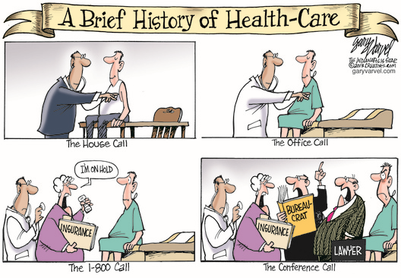

Slide 5
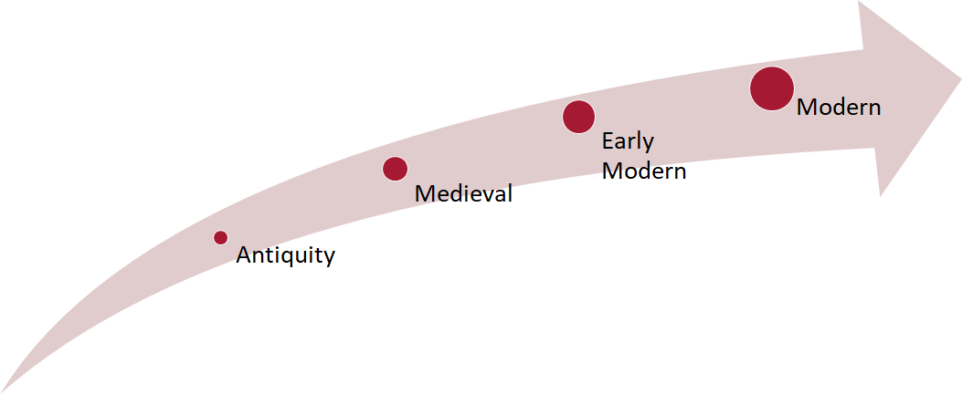
Timeline of Healthcare and Hospitality

Slide 6
Why Hospitality Matters in Healthcare
Increased patient loyalty – For every patient who complains, 20 dissatisfied patients do not, and 90% of dissatisfied patients won’t return. Rush University Medical Center in Chicago calculated that improved patient satisfaction scores translated to $2.3 million in additional revenues annually.
Reduced malpractice claims – A correlation was drawn between patient satisfaction scores showing that each one-point decrease in score is associated with a 5% increase in the rate of risk-management episodes.
Improved efficiency – Stony Brook University Medical Center in New York linked reductions in length of stay and fewer errors after focusing on patient and employee satisfaction, including a jump from the bottom percentile to the 80th percentile in patient satisfaction.
Increased employee and physician satisfaction – Increasing internal satisfaction among employees and providers results in increased referrals and volumes, increased staff retention, and reduced turnover costs.

Slide 7
Why Hospitality Matters in Healthcare
The Financial Imperative
Value-based purchasing
Incentive payments based on “total performance scores.”
Total performance score based on two domains.
Top three organizational priorities for healthcare leaders
(Beryl Institute, 2013)

Slide 8
Medical facility operates like luxury hotel

Slide 9
The Career Crosswalk between Hospitality and Healthcare
Healthcare
Environmental Services
Food and Nutrition
Print Shop
Plant Operations/Facilities
Facilities
Volunteer Services
Patient Transport
Hospitality
Housekeeping
Food & Beverage
Business Office
Engineering
Engineering
Interns
Bell Services

Slide 10
The Career Crosswalk between Hospitality and Healthcare, cont’d
Healthcare
Parking and Valet Services
Mail and Courier Services
Linen Services
Guest Services
Operator Services
Language Services
Medical Spa
Hospitality
Valet Parking
Business Center
Laundry
Front Desk
PBX
Interpretors
Spa Services

Slide 11
Pros Healthcare vs. Hospitality Path
Healthcare Path
Meaningful Work/Saving Lives
Career Growth
Work/Life Balance
Great Benefits
Pay scale is higher
More Stable Industry
Hospitality Path
Access to Travel
Exciting Work
Career Growth

Slide 12
MaineHealth Who Are We?
Our Vision:
Working together so our communities are the healthiest in America.
Our Mission:
MaineHealth is a not-for-profit health system dedicated to improving the health of our patients and communities by providing high-quality affordable care, educating tomorrow's caregivers, and researching better ways to provide care.

Slide 13
Our Values
We set high standards and always strive to exceed expectations
We welcome diverse perspectives, embrace change, and are committed to lifelong learning
We are honest, transparent and ethical, and maintain a culture of trust and accountability
We embrace diversity and recognize the value of each person
We take responsibility for our actions, follow through on our commitments, and approach challenges with optimism
We focus on each individual’s unique needs, and partner with the people we care for, their families and care teams to develop a shared plan.

Slide 14
Maine Health
MaineHealth is comprised of 12 hospitals, and three affiliate hospitals, in Maine and New Hampshire
MaineHealth has over 22,000 employees
There are 1,600 physicians and practices that make up MaineHealth’s Accountable Care Organization.
MaineHealth provides complete behavioral and mental health care, and provides Southern Maine’s only private, not for profit psychiatric hospital.

Slide 15
Maine Medical Center
Maine Medical Center (MMC) is the state’s largest medical center
MMC is licensed for 637 beds, and has more than 9,600 employees.
MMC shares roles as the state’s only allopathic medical school program, and provides the community and entire world with wonderful care, and a full range of referral services.
MMC also encompasses the largest multidisciplinary medical group, Maine Medical Partners.
With 11 other hospitals, and Maine Medical Center as the largest, the collaboration with shared medical records has been unmeasurable.

Slide 16
MaineHealth Center for Workforce Development
Education and Training
* C.N.A Program
* Medical Assistant
* School of Surgical Technology
* Phlebotomy School
Tuition Reimbursement
Language Enhancement
Leadership Training and Organizational Development
Healthcare Career Pathways

